Slide 1


Retail Growth Strategy
March 2020

Slide 2
Successful Retail Growth Strategy
Smart data driven decisions must be made in order to compete in todays retail space
Several factors must be considered (Demand, Competition, Space)
REI customer info derived from the co-op must be used in order to identify Geographic Based Demand for REI products
Care must be taken to identify locations where a new store would thrive with minimal competition and an enthusiastic customer base

Slide 3
Factors To Consider
Demand
Competition
Available Space
Customer profile identifies key demographic variables for analysis (Zip code level data)
Median Income
Consumer Spending and projected consumer spending
Population and Future Population growth
Age of population for key demographic (21 to 44)
Variables should be aggregated on individual zipcodes as well as neighboring zipcodes
Locations of direct competitors as well as existing REI locations that will compete with new store locations
Some locations are direct competition
Some compete against only certain items (bikes for example)
Different weights assigned based on the type of competitor
Existing stores in close proximity to new stores will “cannibalize” each other
Are there available shopping centers in the prime locations where new store space could be leased?
Identify area shopping centers in the prime locations for expansion
See if space is available and at the right price for consideration

Slide 4
Demand
Identify demographic variables that lead to retail success (REI customer data)
Look at not only individual zip code aggregations but aggregate variables based on neighboring zip codes (neighbors are zip codes that share a partial boundary (touch) a target zip code
Use a GIS tool to put like zip codes into groups based on the variable aggregates
Look at Store performance data. What zip code groups contain the highest performing stores?
Consider zip codes in these groups as potential good locations for future stores.

Slide 5
Demand Variables (Zip code level and neighborhood level)
- Total Population
- Total Households
- Median Household Income
- Percent of population 21 to 44 years of age
- Median Age
- Population Growth
- Total Consumer Expenditures 2016
- Average Consumer Expenditures (Ranked)
From the demographic data the above variables were pulled into the database.
The table was output into a feature class in ArcGIS and the Grouping Analysis tool was run to group (based on the variables) like zip codes together.
The top 50 performing stores were identified and zip located. A query was written to identify which of the zip groups housed these stores. (see attached code)
Zip codes in this group are considered areas of high demand based on demographic data. They are potential locations for future stores.
As a tie breaker later in the analysis these variables were also aggregated at the neighborhood level (all zips that touch a target zip) (see attached code)

Slide 6
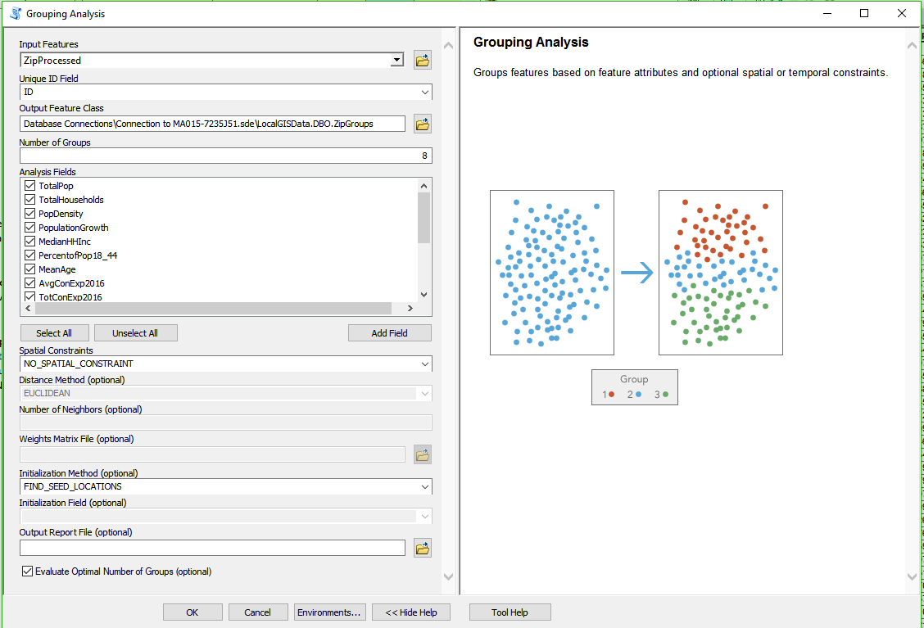
The Grouping Tool on the left used the table attributes to group like zip codes together.
Based on the store performance data the group with the most high performing stores will be considered the zip targets for future expansion.
No Spatial Constraint was used because zips proximity to others within the same group wasn’t necessary. The analysis was more based on the demographic data
Group 4 had 33 of the top 52 performing stores (> $20,000,000 annual sales)

Slide 7
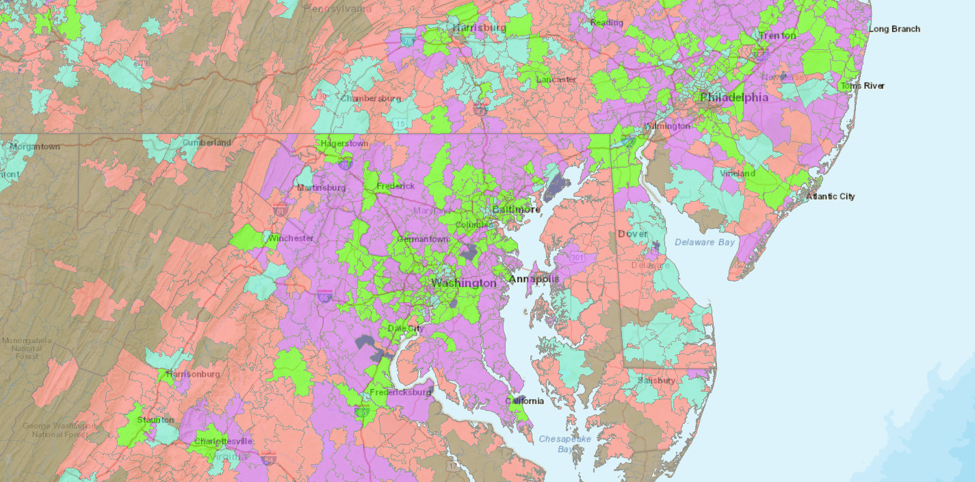
Demand Map – Individual zipcodes were grouped based on demographic variables
The zips in green were the group that contained over-performing, existing REI Stores (group 4). This group will be used as potential future store sites but must be analyzed for competition

Slide 8
Competition
Competitors as well as existing stores have adverse affects on new stores
Not all competitors are equal. Direct competion based on SIC code was identified and the locations were weighted.
Same or similar sic code competitors were considered the most direct competition and they were given a CompetionLevel = 3
Businesses that competed for only partial product lines were given a 2 (For example bikes or clothing stores) and other competitors were given a 1.
A “ZipCompetitionLevel” was calculated based on the number of competitors as well as a sum of the Competition Level calculated previously. This was done with queries in the database and visualized in GIS software.

Slide 9
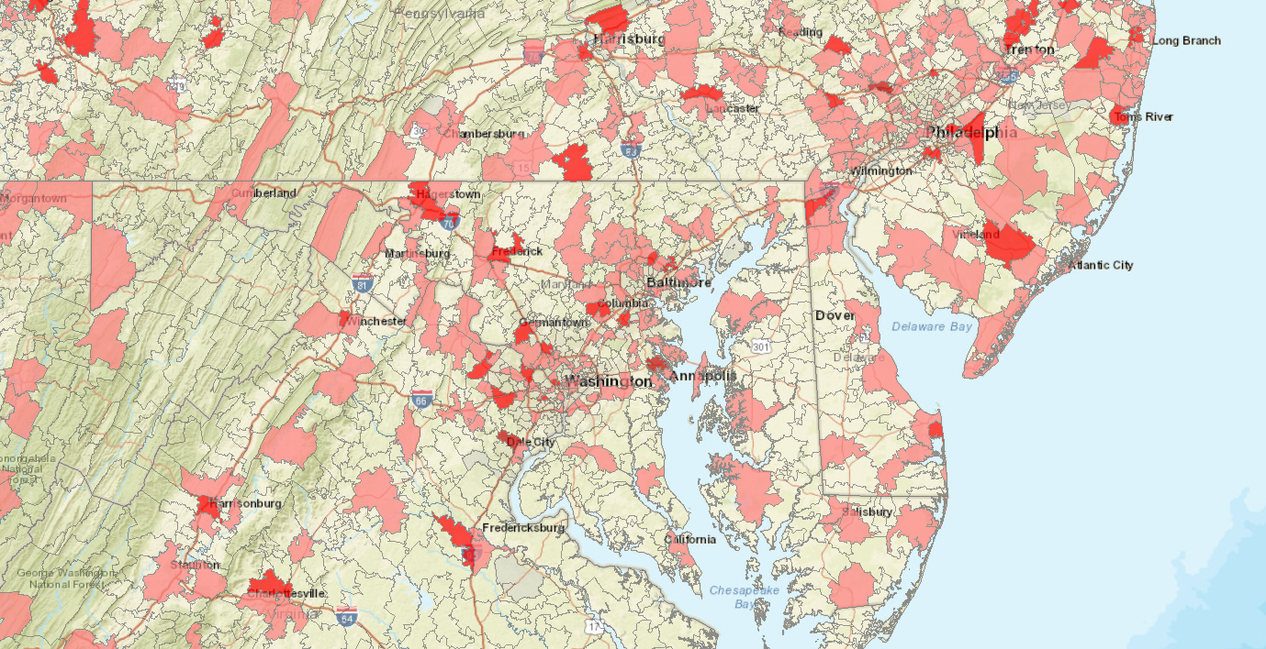
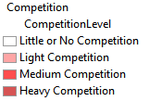
Competition Map – The darker red the more direct and indirect competitor locations
exist in this zipcode . Each zipcode has a Competition Level attribute

Slide 10
Space Available?
New Stores must be located somewhere and ideally somewhere with significant foot traffic (population and shopping centers)
New building construction is expensive and REI brand is typically located in malls or community Strip locations
Shopping center data was imported and counts per zip code were identified
Gross Leasing Area was also summed to get an idea how much space could be available for new locations
GLA is not an indication of available space. Each new location has to be looked at for what space is available (if any).

Slide 11
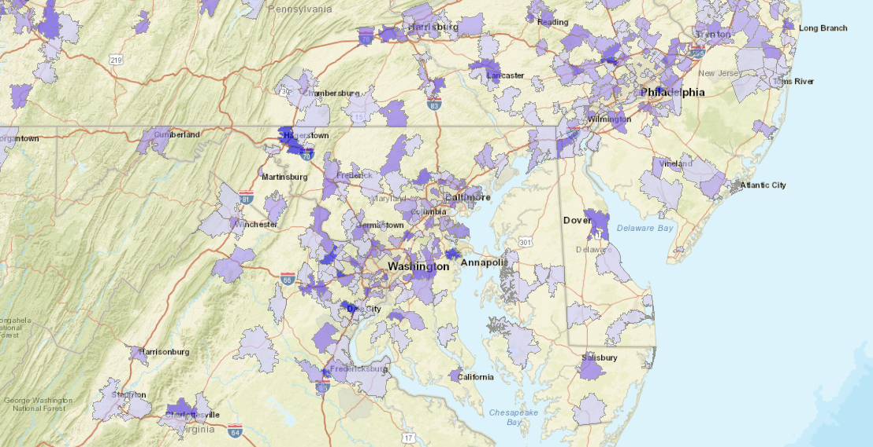
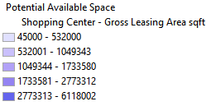
Potential Available Space– The darker blue the more Gross Leasing Area exists within
shopping centers inside the Zip code. GLA is not indicative of Available space

Slide 12
Final Results – Database Table for Visualization
A database table was developed that stored all variables of interest for the study.
All zip codes are part of this table. The Zip Group indicated that Group 4 was most like REI’s existing high performing stores but additional groups were left in for consideration
Queries can be developed that take into account the three variables
Demand
Competition
Space

Slide 13
New Store Query example Database
select *
from REICaseStudy.FinalZipAnalysis
where DemandGroup = 4 -- Based on the demographic variables and over performing store locations
and REI_Store_ID is NULL -- no existing store in the zipcode
and zipcompetitionLevel < 10 -- minimal direct competition
And ZipNeighborCompetitionLevel < 50 -- neighbor based competition (zips that touch target zip)
and NumberofShoppingCenters > 0 -- is there an existing location for a new store?
This query can be run to get results in spreadsheet format for further analysis. All variables are
available and can be filtered to get different result sets.
It’s hard to visualize these results so a better alternative is to query the features on a map

Slide 14
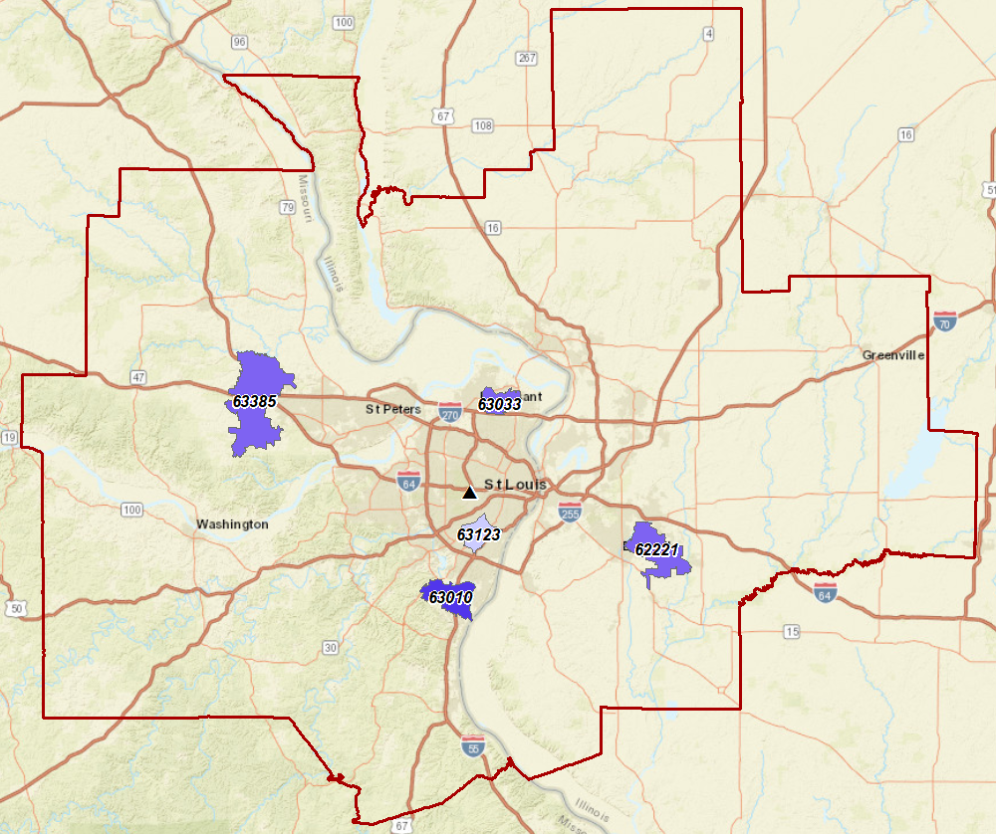
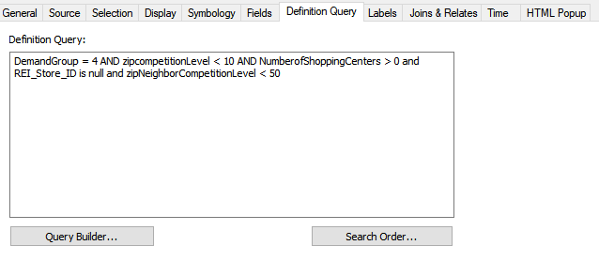
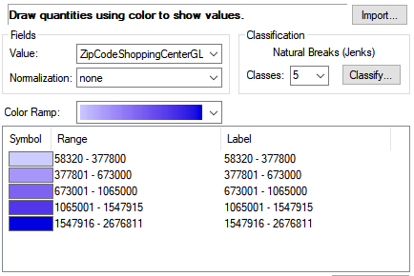
New Store Query example GIS St. Louis CBSA
Individual zips that fit the query criteria are
displayed and symbolized by GLA in shopping
centers within the zip code. Zip 63010 looks like
a potential site for expansion

Slide 15
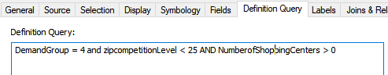
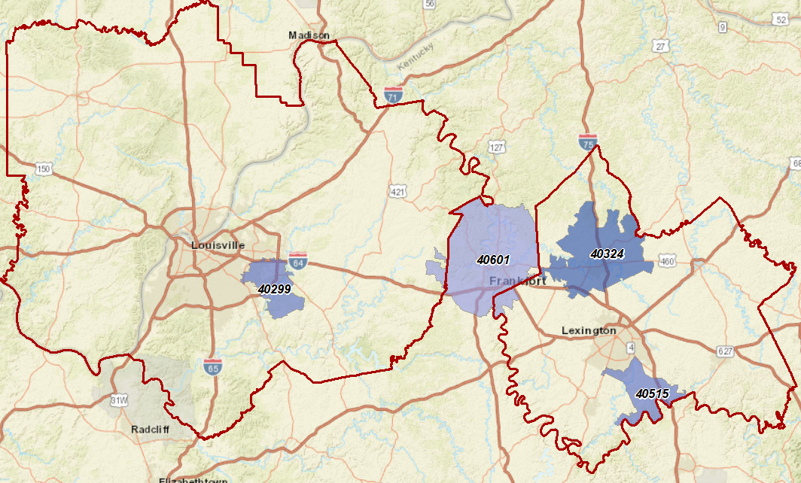
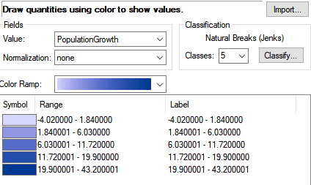
New Store Query Example - GIS Louisville/Lexington Kentucky CBSAs
No stores exist in these two CBSAs. Considerable competition exists but could new stores be
located in these areas? Dark blue indicates higher project population growth.

Slide 16




Conclusions and Future Potential
Zip based approach allows flexibility for what-if scenarios
Individual zip variables are useful but it’s best to consider these as well as the variables aggregated by zips in close proximity
Additional information such as current available space or additional demographic variables can be added to the final table when zip level sources become available.
Consider making a simple ArcGIS online (or open source webapp) to allow REI stakeholders to query the information and further analyze the results. Online collaboration would allow individuals with local knowledge of the CBSAs to contribute additional information to store location choices

Slide 17
Thanks
Any Questions?

Slide 18
BCG Evaluators
Main software used in this case study was a local instance of SQL Sever and ArcGIS software
All datasets were either imported into SQL Server directly or through ArcGIS software using a
Database connection
Attached to this submission is all of the SQL code I used to generate the preliminary and
final tables. I didn’t want to include this code in the powerpoint because it wouldn’t typically
be something I would provide to a client (to in the weeds)
This is just one of the potential ways of doing this type of project and I would welcome the
opportunity to discuss my methodology .
If you have any questions or would like clarification on any of this Case Study feel free to
reach out to me at j.Portolese@comcast.net
Thanks for your consideration.
Jamie Portolese

